Slide 1
DOREMON DEN-2T
GROUP 8
Team:
-Shreya Murarka
-Sohail Mulla
-Vivek Rastogi
-Deepak Kumar

Slide 2

STRUCTURE
- Product Critique
- Improvement Goal
- Present Market Scenario & Competitors
- Personas
- Key Pain Points
- Solutions
- Prioritisation
- Metrics
- Summary

Slide 3

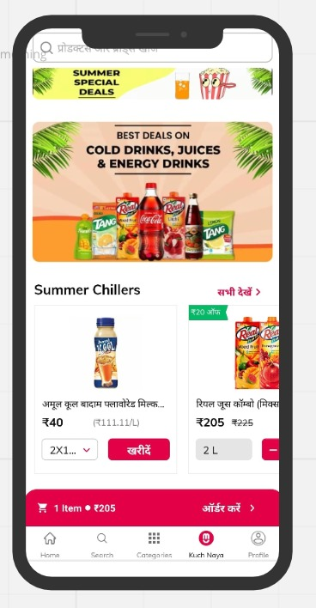

‘KUCH NAYA’ TAB , CITY MALL APP
Parameter | Pros | Cons
Innovation | The tab shows products according to the seasons as well ,for example it displays summer chillers for summers. | Doesn’t show personalized options according to previous purchases. Improper use of screen space by displaying categories repetitively.
Utility | Displays best selling products Leaders can send the best deals directly over whatsapp to increase their sales. Shows some great deals and discounts on products. | The tab doesn’t justify its name. It doesn’t show the newly launched products.
Ease of Use | Easy UI and can be used by anyone because of hindi language. Categorization of items for ease of selection. | According to the customer reviews, the user experience is very poor ,the app hangs a lot. Language changing option is not there.
PRODUCT INFO
Working: It helps the users to select & order some of the best selling products with a good amount of discount.
Value Proposition:Recommends the bestselling products and products according to time and situation, with a good amount of discount.
BUSINESS OBJECTIVE
Objective is to target tier 2 and below cities by creating a chain of virtual stores on WhatsApp & through a network of neighbourhood community leaders.
PRODUCT CRITIQUE
Kuch Naya
USER TYPES:
Buyers use this tab for getting some new deals and offers and look for
some new products.
USER JOURNEY
Home Page
Enter mobile no.
Enter OTP
Enter Address
Leader Assigned

Slide 4
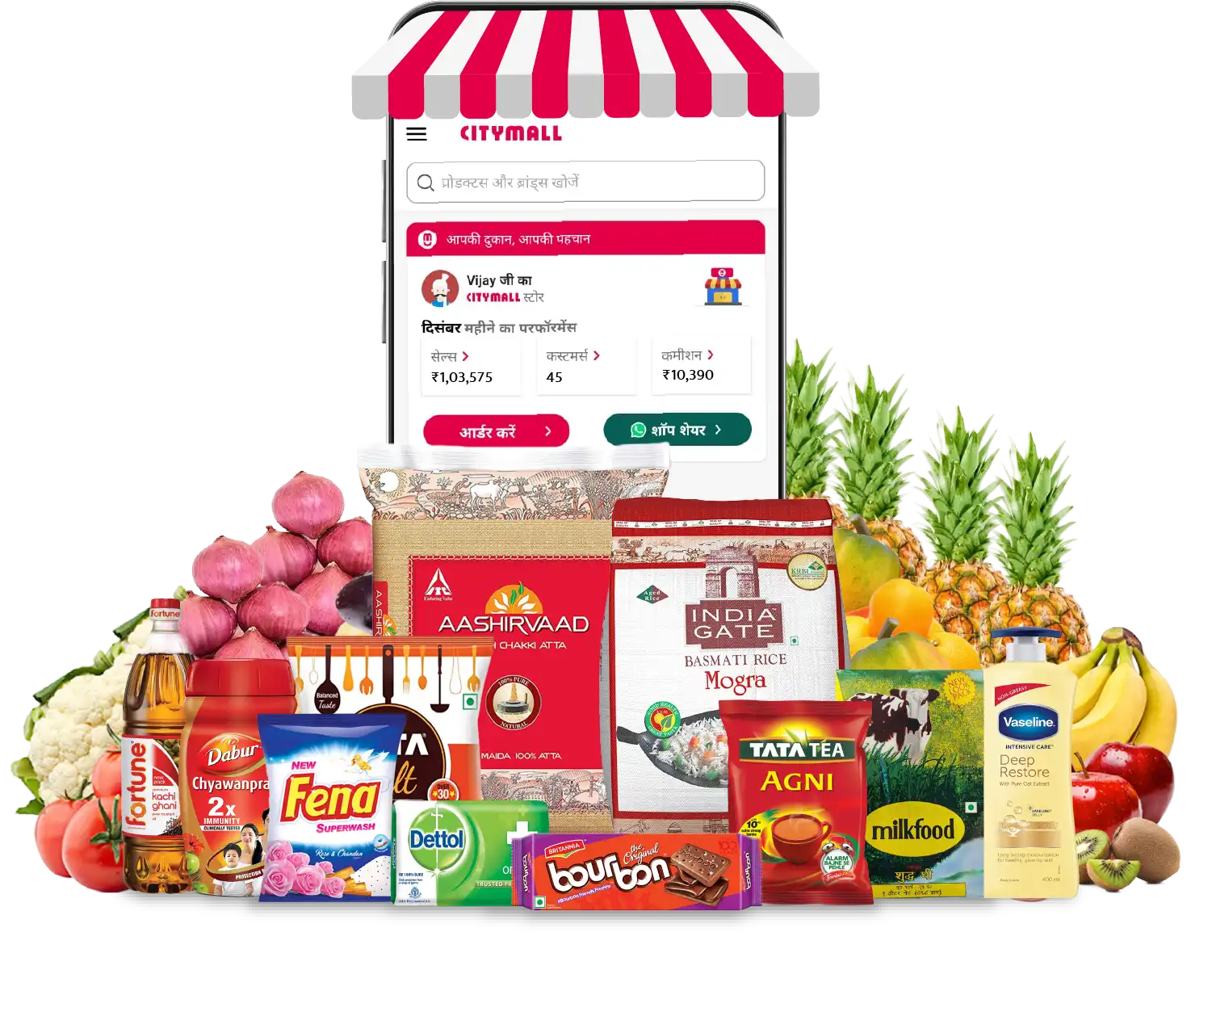
Effectiveness of ‘Kuch Naya’ Tab
IMPROVEMENT GOAL

Slide 5
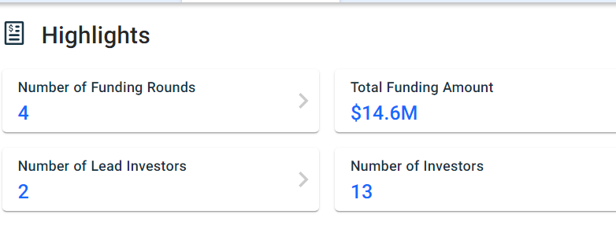





“India’s next 300 million Internet users from smaller cities, towns, and villages depend on assisted commerce formats driven by pricing, trust and feasibility to encourage online purchase for everyday products.
Present Market Scenario & Competitors
CityMall is a social e-commerce platform that sells lifestyle, grocery, and curated products via peer-to-peer referrals on WhatsApp, across tier 2, 3 and 4 towns and cities.
CityMall has close to 20,000 resellers that serve over 2 lakh customers across their communities.
Competitors:
CityMall has raised a total of $14.6M in funding over 4 rounds. Their latest funding was raised on Mar 25, 2021 from a Series A round.
CityMall is funded by 13 investors. Accel and Jungle Ventures are the most recent investors.

Slide 6
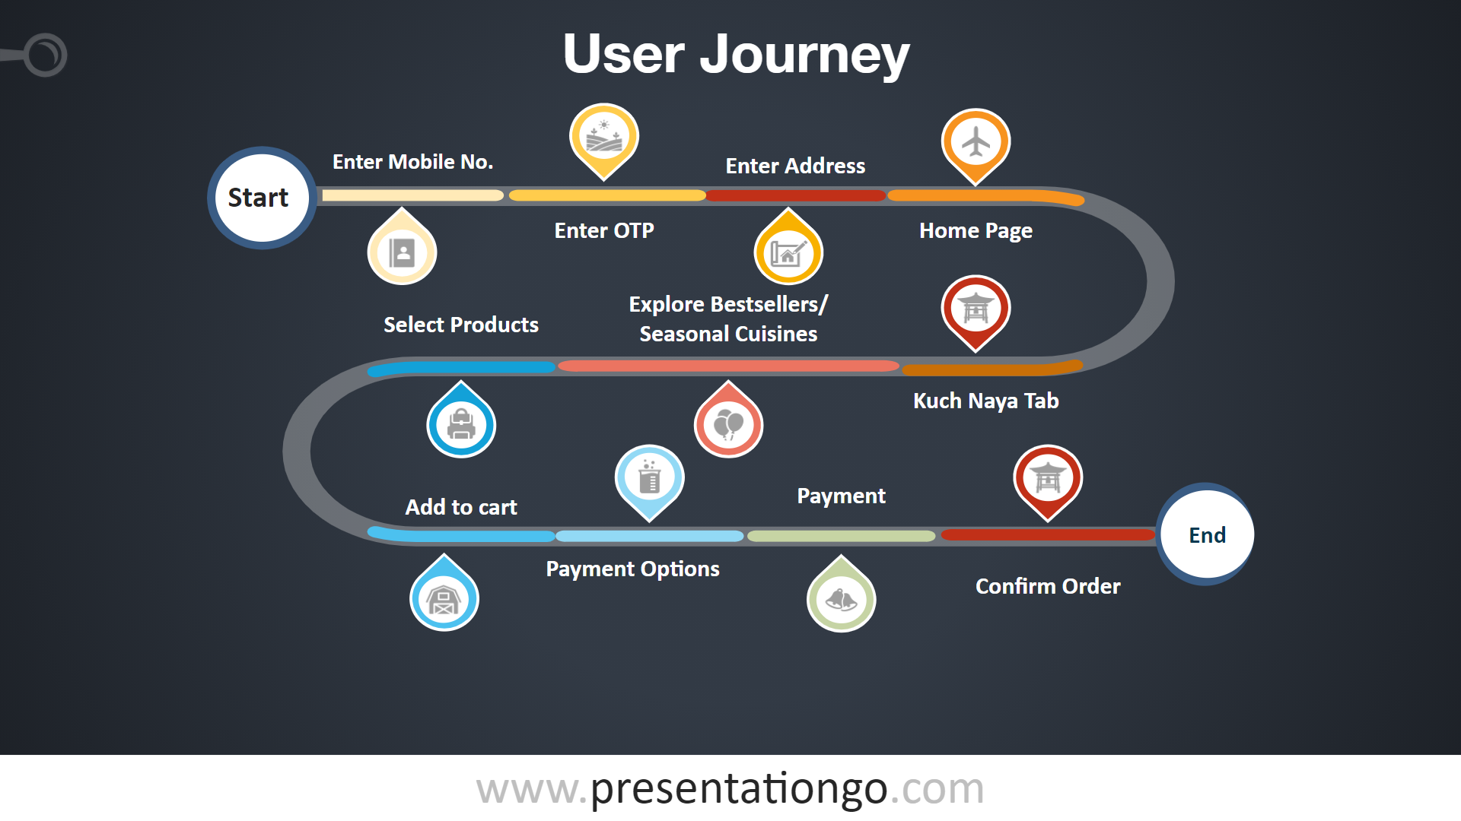

Slide 7



ANUPAMA
SHYAM
24 yrs, Student , 9-5 busy, Lives with friends
Busy, Messy lifestyle, want to get things done quickly, Good with using ecommerce.
Goals
Regular order , want optimized prices.
Don’t prefer travelling.
Party special’s cuisine according to no. of people.
Easy selection process
Willing to play games etc to avail offers.
Looking for new products that are coming to market.
Pain Points
Can’t order more than 100 rupee.
Non tempting .
Non-personalized.
Bad UI /UX i.e,repetition of same options again & again.
33 yrs , small Business owner, married ,Male
Busy, Runs a small business
Goals
Cheap raw materials for his stall
Fixed capital investment
Perishable goods
Clothes and toys for family
Easy UI
Pain Points
Not many offers or opportunities to bargain
Bad Ux
Less knowledge about the e-sector(lack of trust).
On time delivery.
Personalized options required.
BABURAO GANPATRAO APTE
35 yrs, Housewife,Middle Class,Lives with child and husband,Busy with household chores all day.
Goals
Maximize the savings part.
Avoid the hassle of travelling.
Quality items preferred.
Want her query solved from time to time while using the app.
Pain Points
Not getting as much discount as expected.
Want to get rewarded for being a regular customer.
Not able to find the latest products on the tab.

Slide 8

KEY PAIN POINTS
Not getting as much discount as expected.( Want more offers)
Not able to find the latest products in any category on the tab.
Bad UI i.e,repetition of same options again & again.
Need to build trust among users, a kind of quality check required on leaders and products.
Need more user personalized features and recommendations.

Slide 9
SOLUTIONS-
It can display products recommended by other buyers of same psychographics.
More personalized option according to last few purchases.
To keep a check on leaders, quality of product.
To Conduct weekly games to avail them exciting prizes,discount coupons etc.
To track the most interactive and regular customers to avail them of discount offers.
A section showing newly launched products in different categories.
Notification to be sent if some new product is launched and available in the app.
Community Leaderboard
Recommendations Section
Display &Notify
Along with games weekly surveys are also created to keep a check on buyer -leader relation and those participating will gain points.

Slide 10
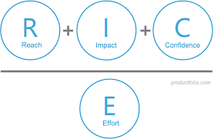
PRIORITISATION-
Feature | Reach | Impact (3/2/1/0.5/0.25) | Confidence (100/80/50) | Effort | RICE Score ([R*I*C]/E )
RECOMMENDATION SECTIONS | 90,000 | 0.5 | 50 | 2(tech) | 22,50,000/2 =11,25,000
Community Leaderboard | 50,000 | 2 | 80 | 2(maintaining portal , leaderboard),1 (for games) | 40,00,000/3 =13,33,333
Display & notify latest products | 80,000 | 0.5 | 50 | 2 | 20,00,000/2 =10,00,000
RICE Framework
Expected customers- 1 lakh.
Hence, community leaderboard is our chosen solution.

Slide 11
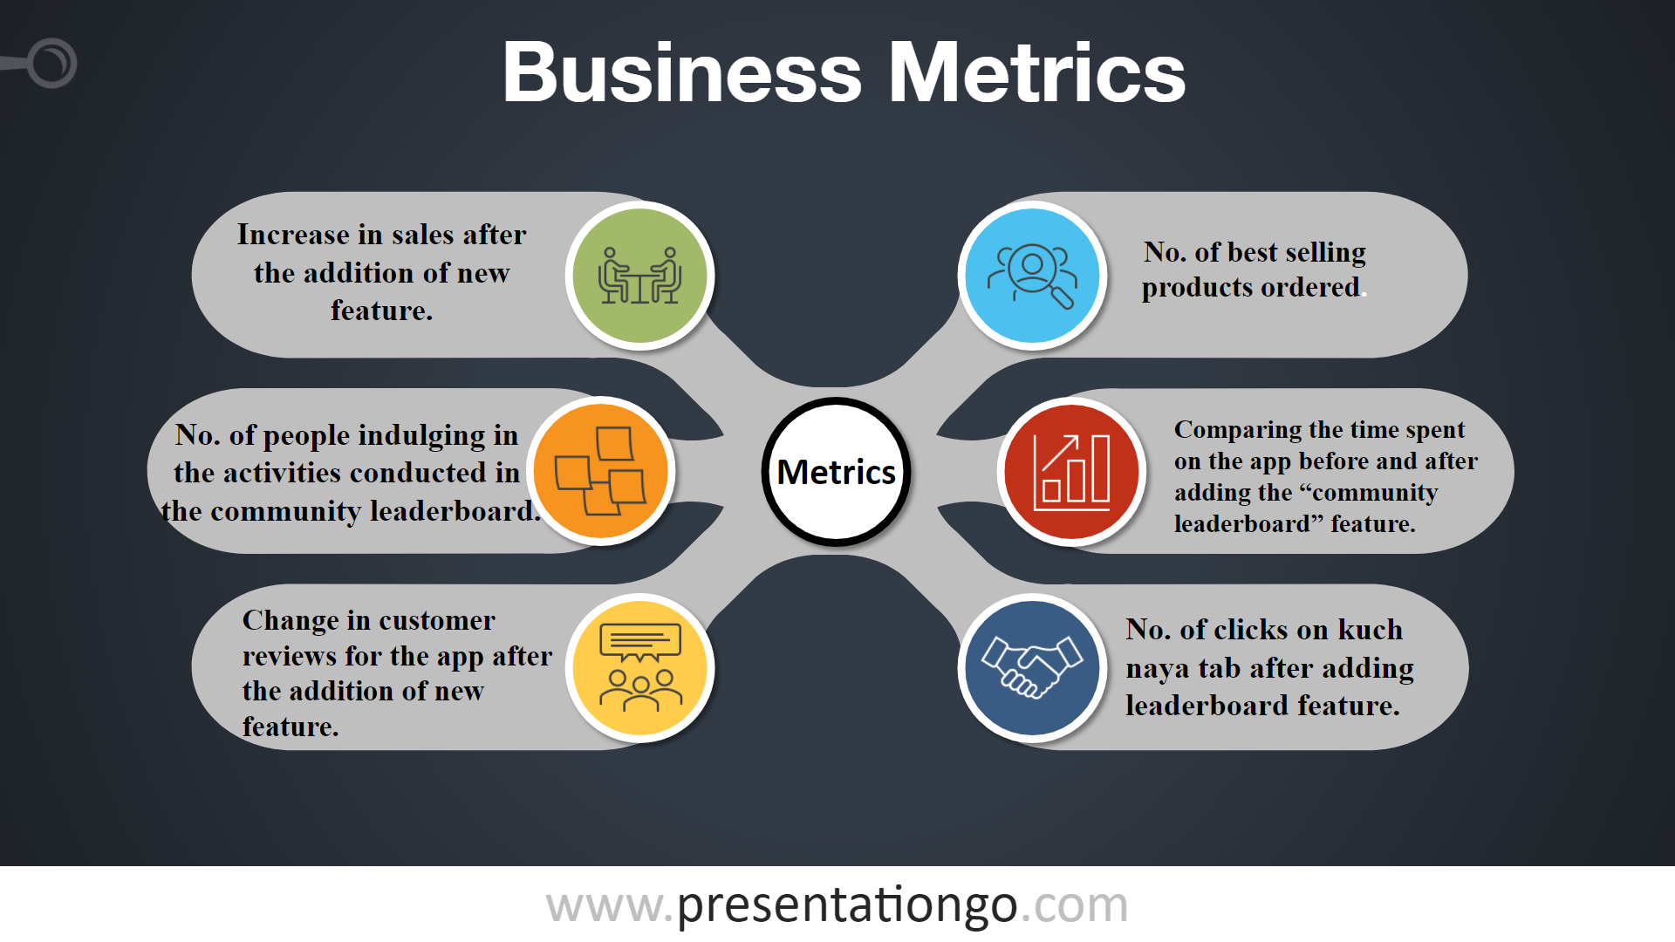

Slide 12
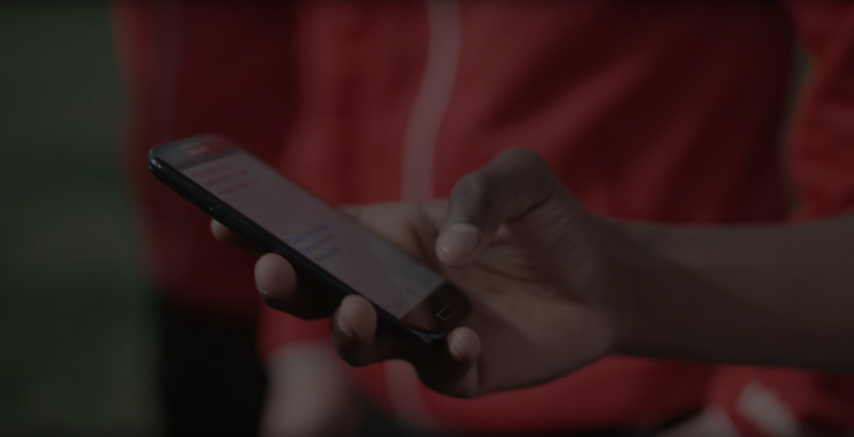
SUMMARY-
We studied the app thoroughly , researched about the objectives and strategies of the app.
We did the persona research from the point of view of buyers as this app is mainly for the use of buyers.After going through the pain points carefully we narrowed down our improvement solution to three features:
Recommendation Section
Community Leaderboard
Display and Notify
We chose the solution “Community Leaderboard” for improvement on the basis of Prioritization table calculations.
Some of the key features of our solution includes:
More user engagement by conducting weekly games and surveys in return providing points & discounts to the buyers.
To keep a check on buyer - leader relation through our surveys.
Our app provides some unique solutions to promote a fulfilling experience for users along with great user experience of the app.
THANK YOU!!

